Slide 1


Slide 2

What is CV ?
A CV, or curriculum vitae is a document that summarizes your education, work experience, skills, and achievements. A CV is often used to apply for academic, research, or teaching positions, or when applying for scholarships or grants.
Not only when applying for jobs .

Slide 3
Resume … What is this ?
A resume is usually one or two pages long, while a CV can be longer and more detailed. A CV can also include additional information, such as publications, awards, memberships, or hobbies.

Slide 4
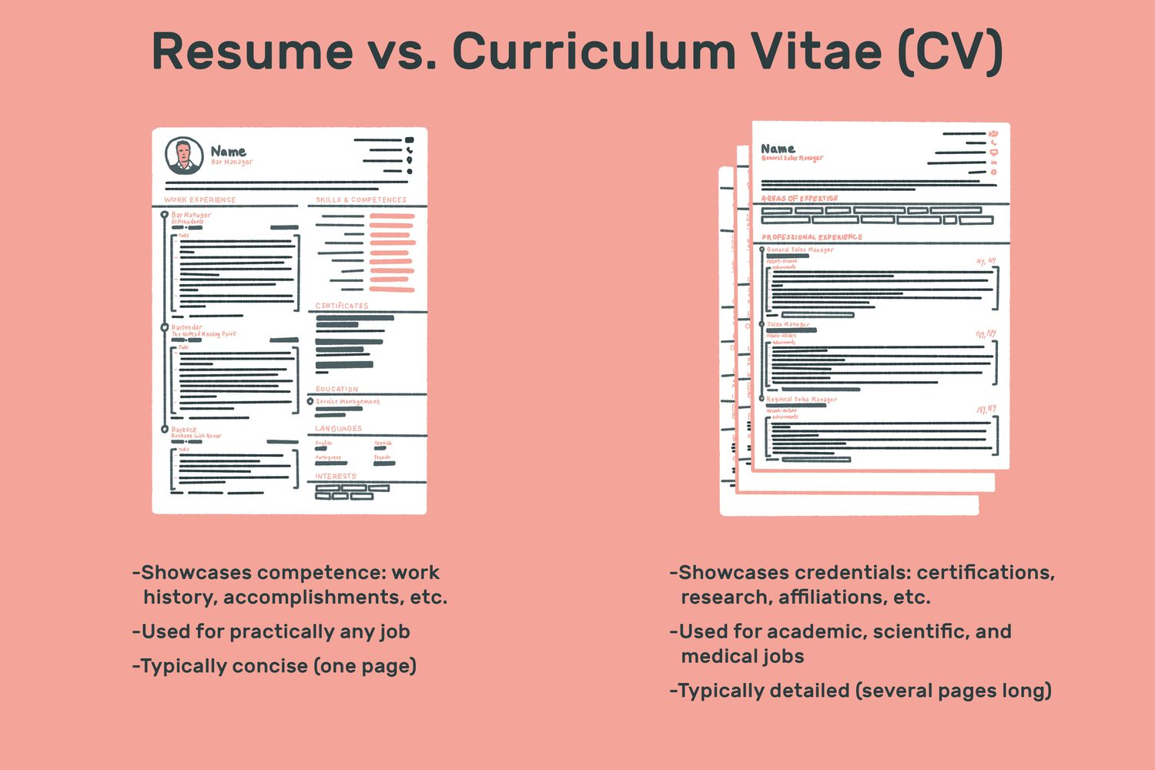
Got Confused ?
A CV is different from a resume, which is a shorter and more concise document that focuses on your relevant skills and qualifications for a specific job.

Slide 5

CV & Presentation Skills… Related ?
Goals .
Tips.
Rules.
Extra mile.

Slide 6
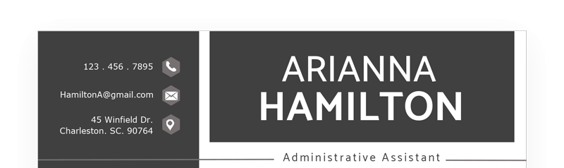
How to begin
Choose the right CV format. 1- Chronological. 2- Functional. 3-hybrid.
Add your name and contact information.
Write a personal profile or summary , This is a short paragraph .

Slide 7
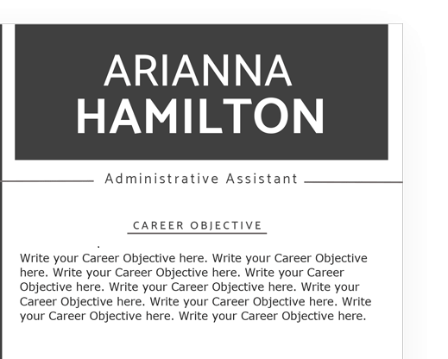
Sentences to include as an introduction
You could write: “I am a creative and enthusiastic graphic designer with over five years of experience in creating logos, flyers, posters, and websites for various clients. I have a BA degree in Graphic Design from the University of Sydney and a portfolio of diverse and innovative projects. I am looking for an opportunity to join a dynamic and reputable company where I can apply my skills and learn new ones.”

Slide 8
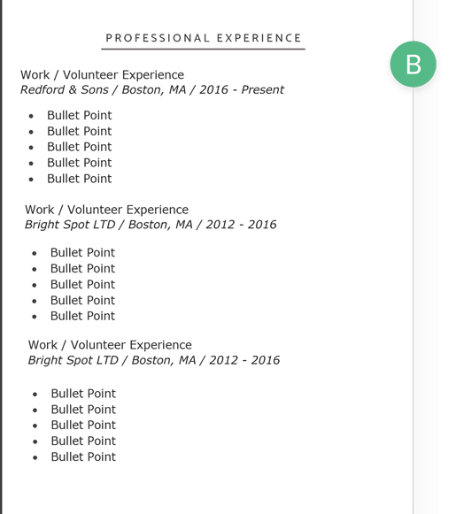
Your work Experience
This is the main part of your CV where you showcase your professional background and accomplishments.
You should list your work experience in reverse chronological order.
Under each job, write two or three bullet points that describe your main duties and responsibilities, as well as any achievements or awards that you received or contributed to.

Slide 9
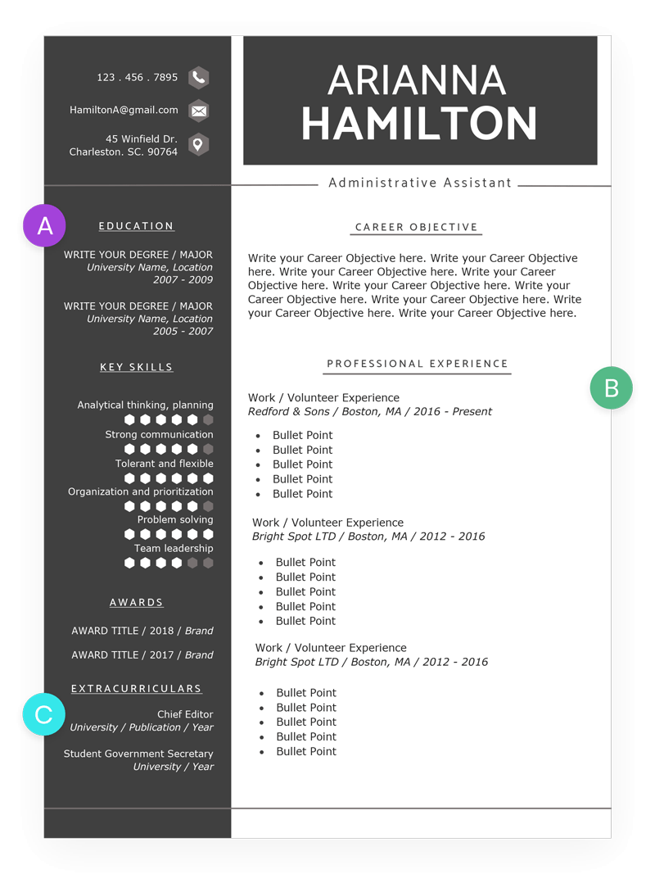
Education Section
Include your education and qualifications.
should list your academic background and any relevant certifications or courses that you have completed or are currently pursuing.
You should also mention any honors or awards that you received or any projects or publications that you were involved in.

Slide 10
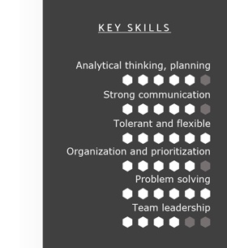
Skills
Highlight your relevant skills.
List any skills that are related to the job you are applying for and that can set you apart from other candidates.
You should include both hard skills and soft skills
You should also mention your level of proficiency or expertise in each skill.

Slide 11
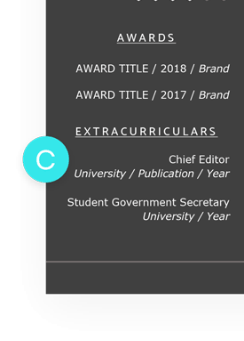
Awards and Extracurriculars

Slide 12
Let’s retrieve all
Name and contact information.
Personal profile or summary.
A few words about yourself
Your professional skills.
Your education.
Key skills.
Awards and Extracurriculars (Optional).

Slide 13
The Big Picture

Slide 14
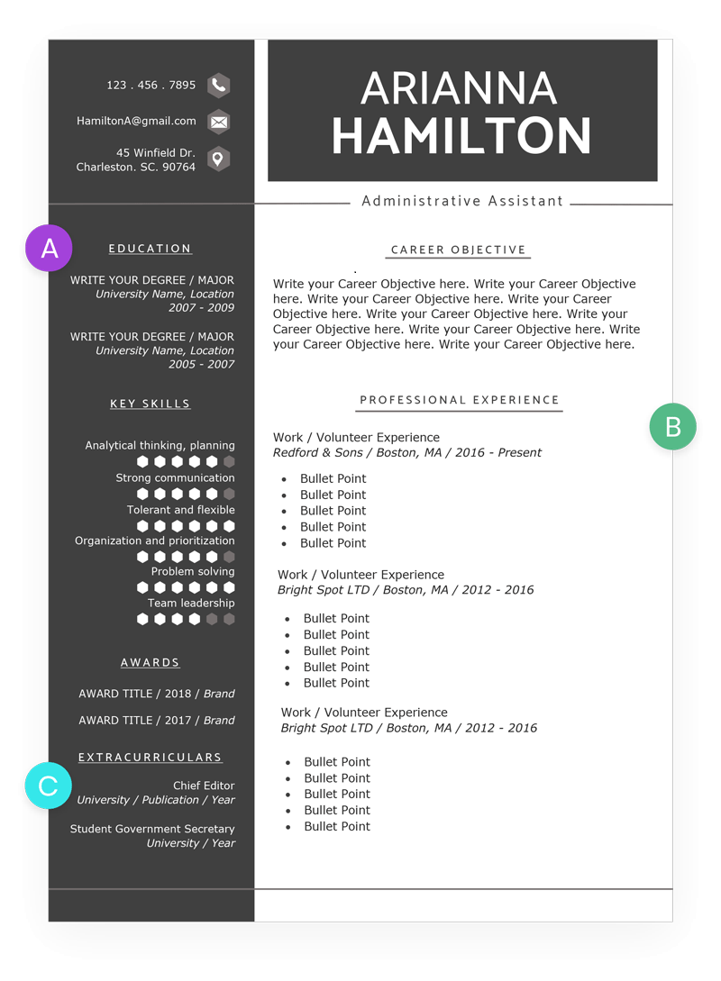

Slide 15

Not To DO

Slide 16
Finally
There is no perfect CV model
Create Your own one with your own creativity.

Slide 17

Okay… There is one more
Websites to help you with your CV : Free Resume Builder: Create a Professional Resume Online (zety.com) Free CV Maker: Create a Curriculum Vitae Online | Adobe Express The Best Resume Builder Apps in 2023 - BestApp.com

Slide 18

Thanks

